Slide 1


PROJECT
3º Sprint Review
Turma B - Grupo 5
1170053 – Pedro Diniz
1211757 – Daniel Torres
1211759 – Diogo Veloso
1211765 – Gisela Araújo
1211779 – Márcio Carvalheiro
1211785 – Maurício Barros
1211788 – Patrick Rodrigues
1211797 – Tânia Mota
1211799 – Tiago Machado
1211801 – Valter Sousa

Slide 2
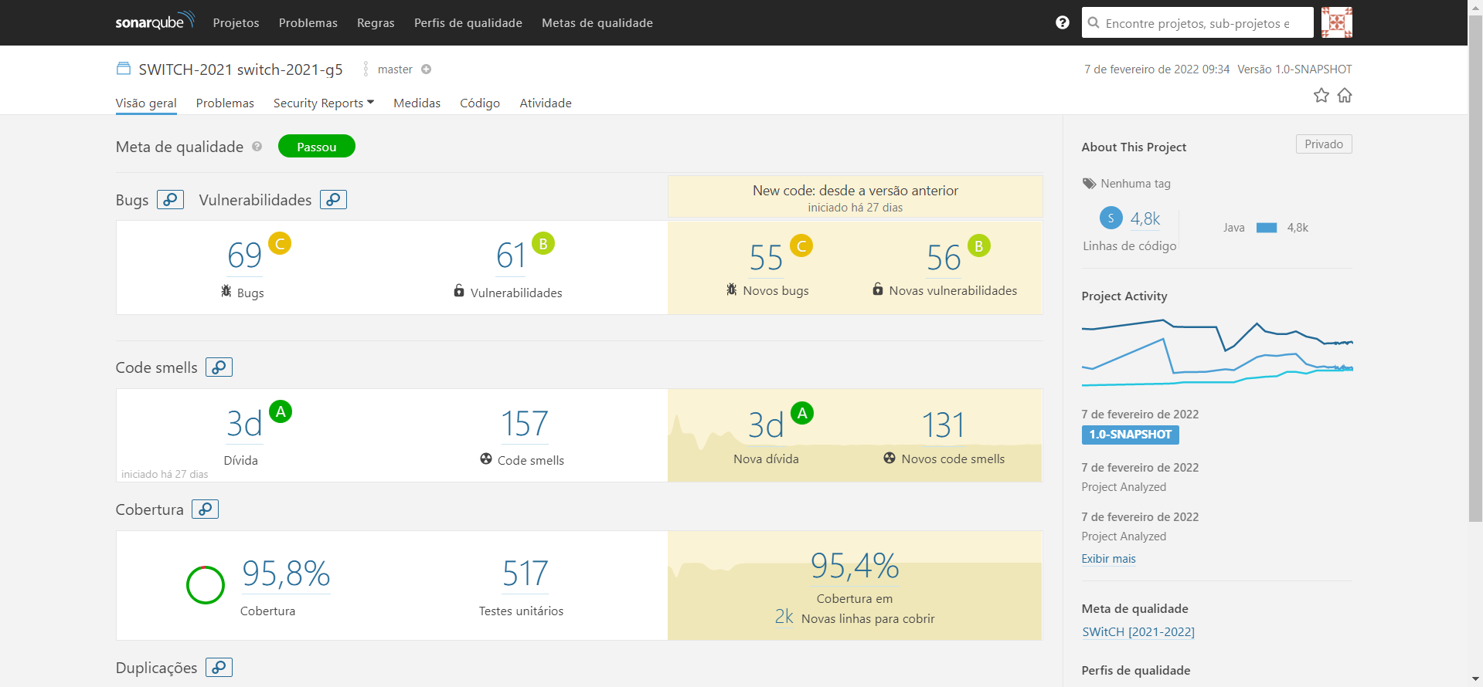

Slide 3
US31
As Team Member, I want create a task in a user story.

Slide 4
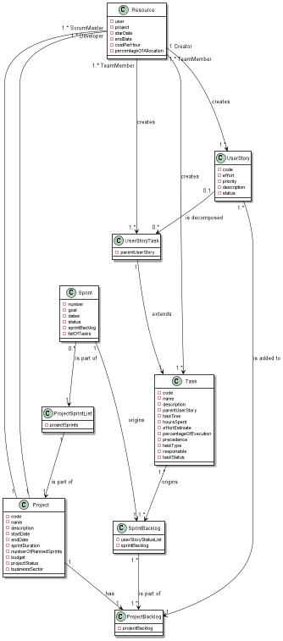
US 31 – Domain Model Excerpt

Slide 5
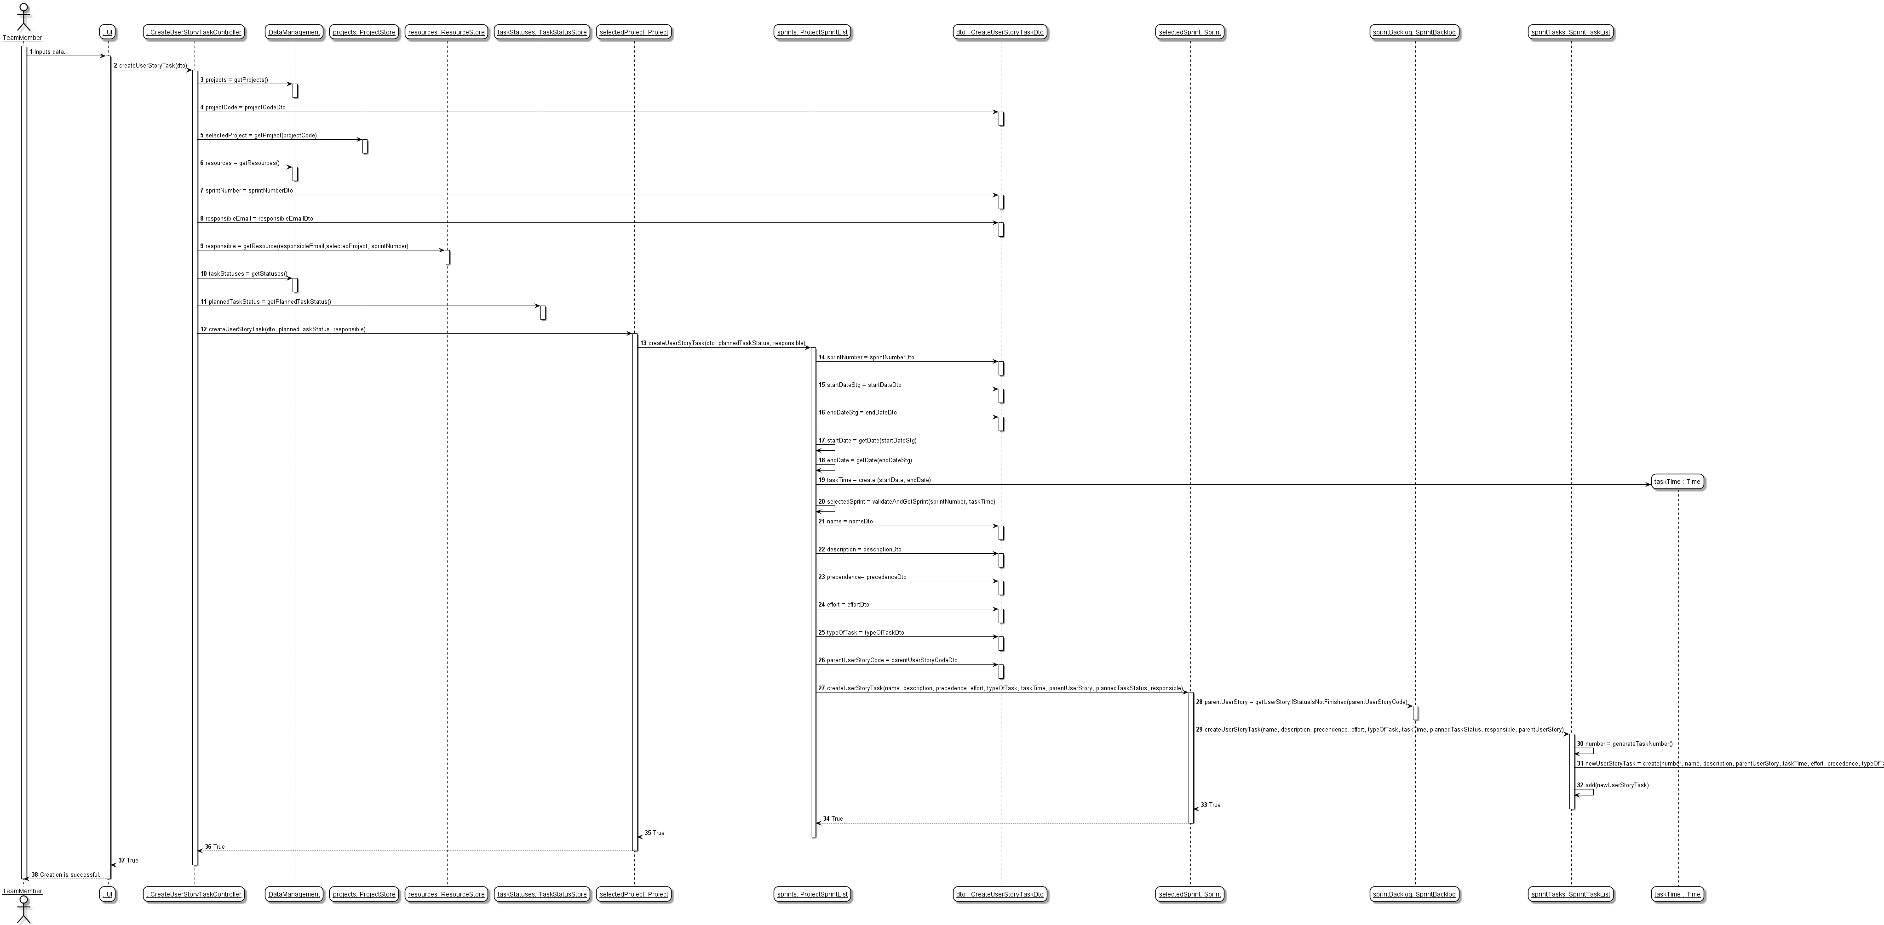
US 31 – Sequence Diagram

Slide 6
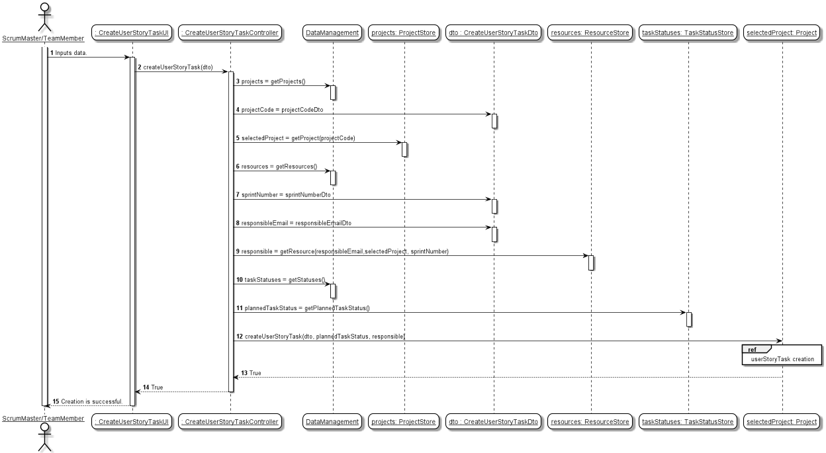
US 31 – Sequence Diagram

Slide 7
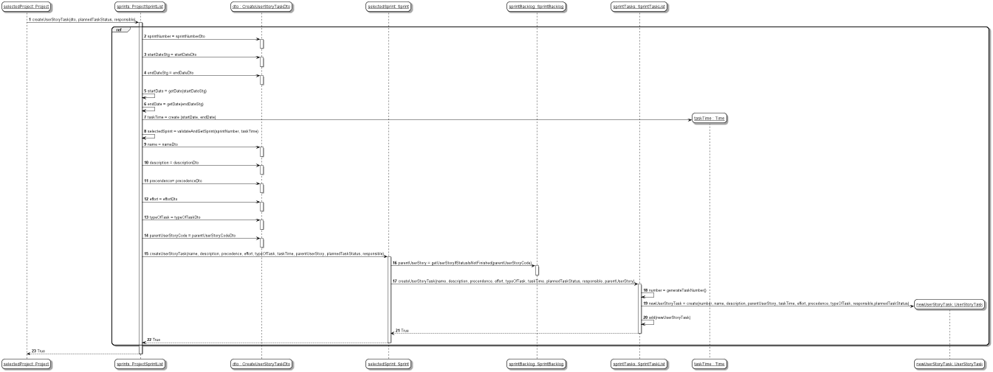
US 31 – Sequence Diagram

Slide 8
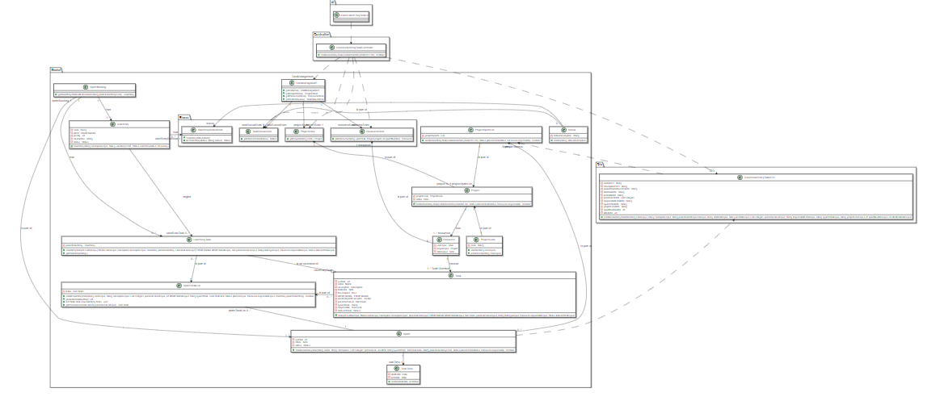
US31 – Class Diagram

Slide 9
Unit Tests JUnit
UNIT TEST 1: Creation of USTask is successful even though it doesn't have precedence list of tasks.
UNIT TEST 2: Creation of USTask is successful even though it doesn't have precedence list of tasks and valid Parent User Story.
UNIT TEST 3: Creation of USTask is successful having a precedence list with two valid tasks.
UNIT TEST 4: Creation of USTask is successful having a precedence list with one valid task.
UNIT TEST 5: Creation of USTask is successful even though it doesn't have a valid resource associated.
UNIT TEST 6: Creation of USTask is successful even though the selected User Story is invalid because its status is finished.
UNIT TEST 7: Creation of USTask Fails because Project is Invalid.
UNIT TEST 8: Creation of USTask Fails because Sprint is Invalid.
UNIT TEST 9: Creation of USTask Fails because Sprint Status is Done.

Slide 10
US24
As Administrator, I want to get a list all user accounts and their status

Slide 11
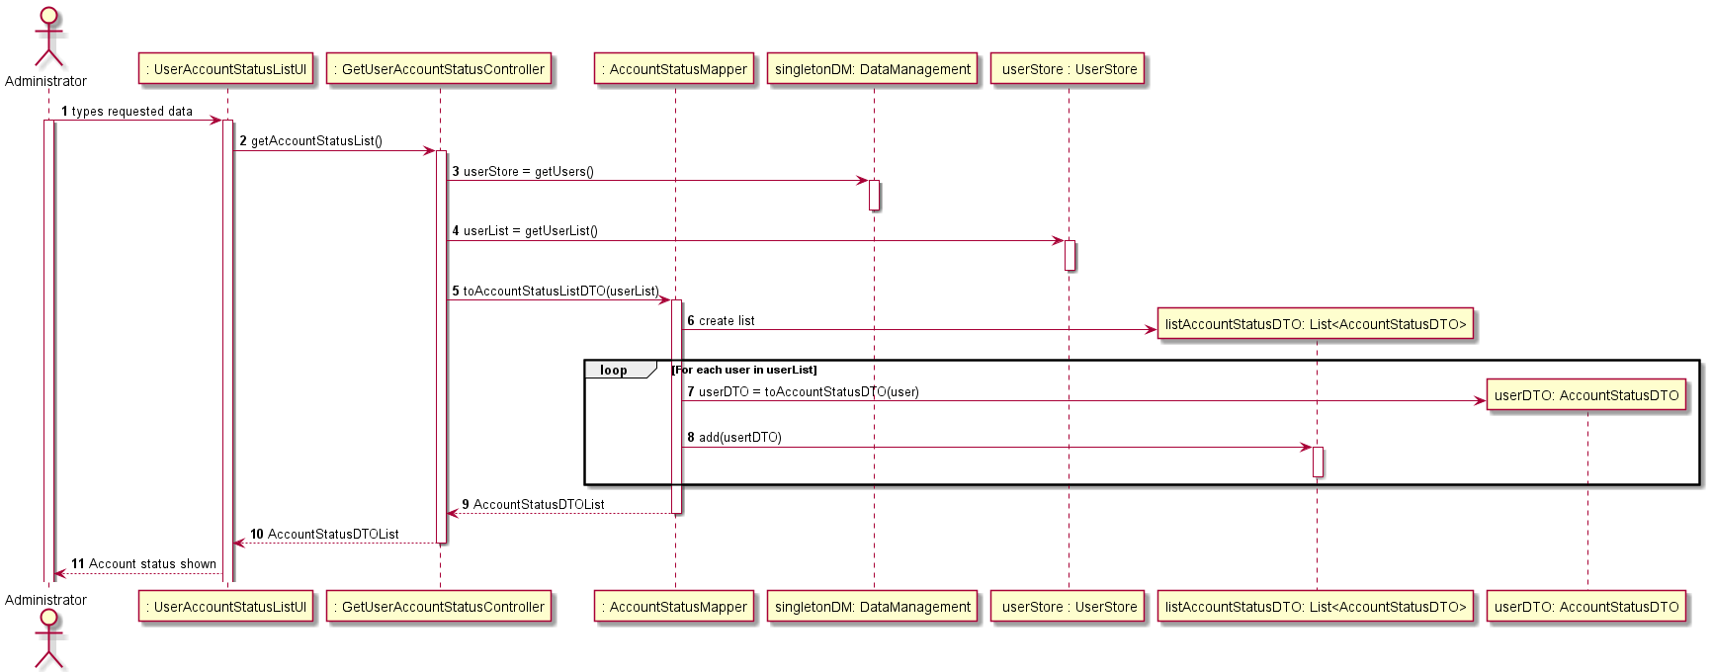
US 24 – Sequence Diagram

Slide 12
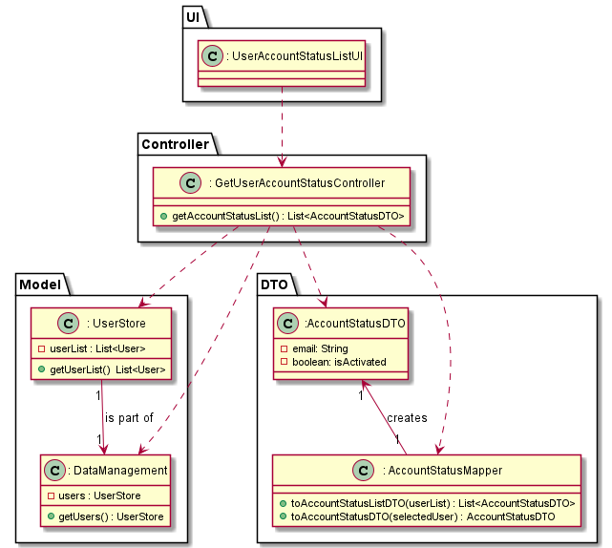
US24 – Class Diagram

Slide 13
Unit Tests JUnit
Test 1: Verify when there are no users in the system, the methods return an empty list.
Test 2: Verify when there is a single user in the system, the methods return a list with that single user.
Test 3: Verify when there are several users in the system, the methods return a list with several users.

Slide 14
US25
As administrator, I want to inactivate a user accounT.

Slide 15
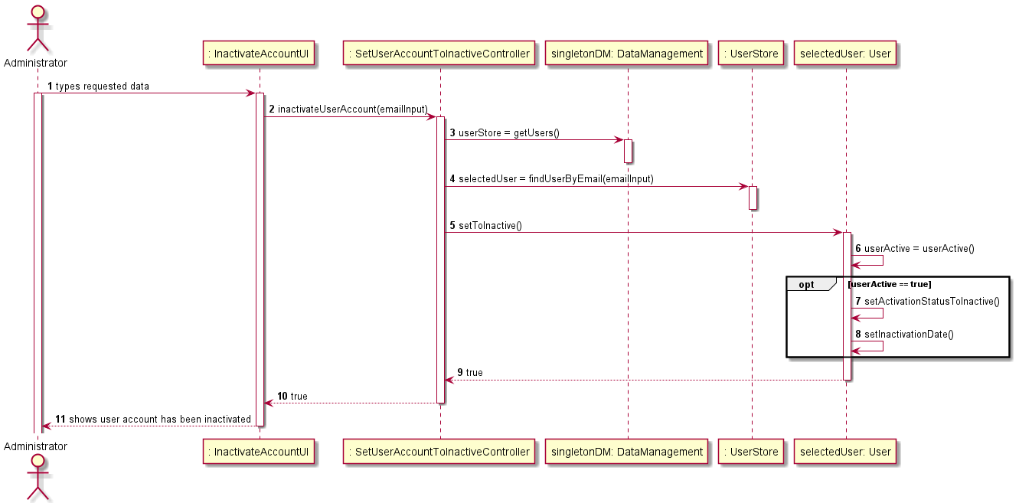
US 25 – Sequence Diagram

Slide 16
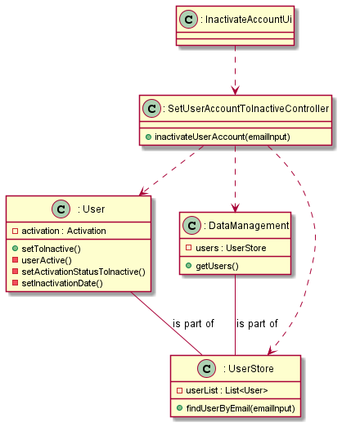
US25 – Class Diagram

Slide 17
Unit Tests JUnit
**Unit test 1:** Sucesfully inactivate an user account.
**Unit test 2:** Fail to inactivate when the user is already inactive.
**Unit Test 3:** Verify that the inactivation date is set when user is inactivated.

Slide 18
US26
As Administrator, I want to activate a user account.

Slide 19
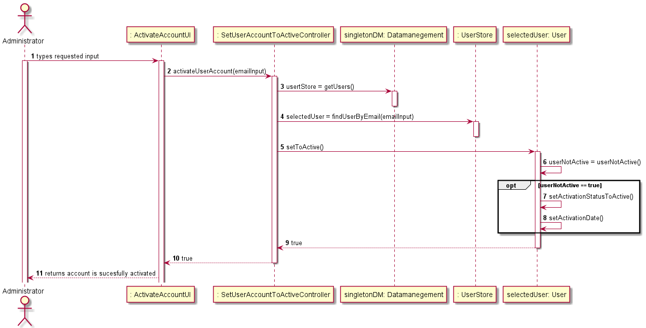
US 26 – Sequence Diagram

Slide 20

US26 – Class Diagram

Slide 21
Unit Tests JUnit
**Unit test 1:** Sucesfully activate an user account.
**Unit test 2:** Fail to activate when the user is already active.
**Unit Test 3:** Verify that the activation date is set when user is activated.

Slide 22
US27
As Director, I want to define the po of a project

Slide 23
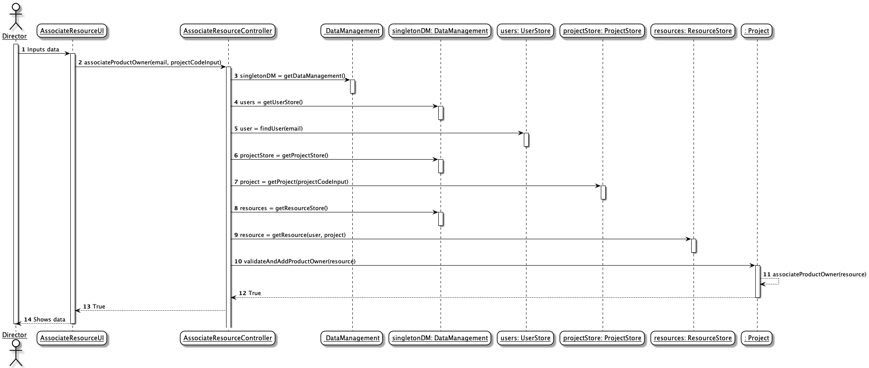
US 27 – Sequence Diagram

Slide 24
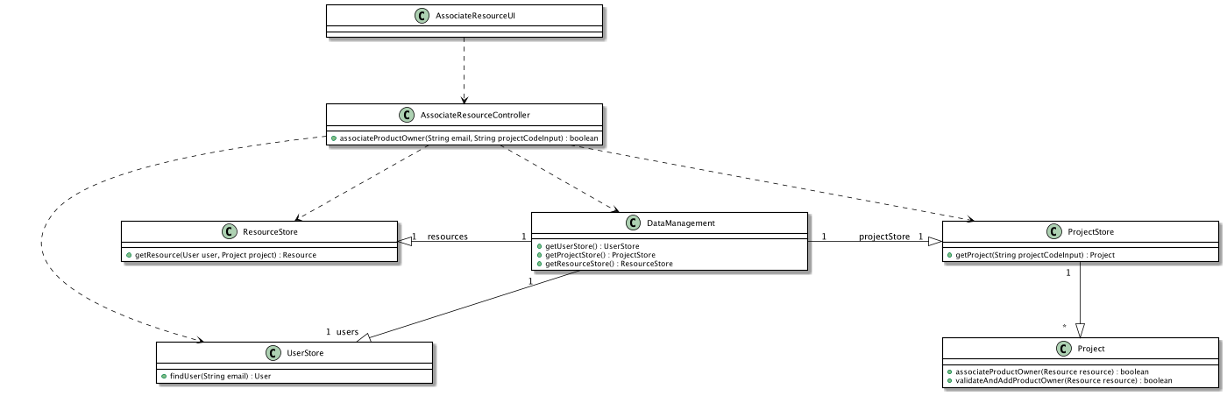
US28 – Class Diagram

Slide 25
Unit Tests JUnit
Unit Test 1 - productOwnerOfProjectSuccessfullyDefined()
Unit Test 2 - associateProductOwnerFailsBecauseNotValidEmailInput()
Unit Test 3 - associateProductOwnerFailsBecauseNotValidProjectCodeInput ()

Slide 26
US28
As Director, I want to get a list of all human resources in a project.

Slide 27
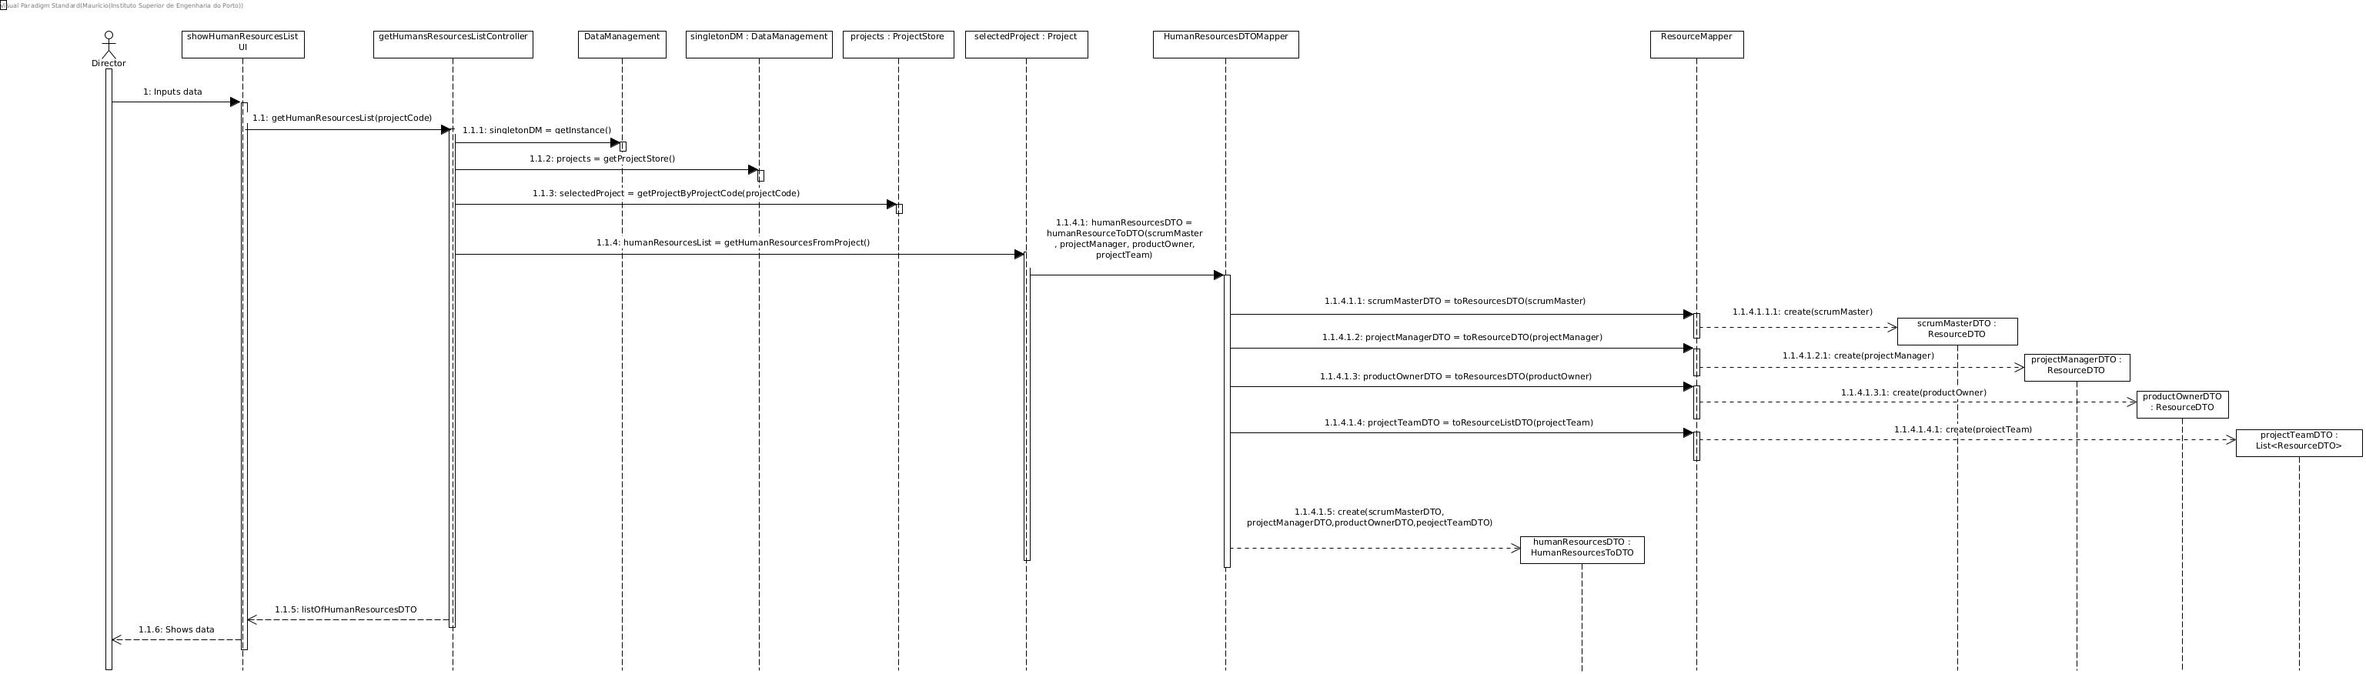
US 28 – Sequence Diagram

Slide 28
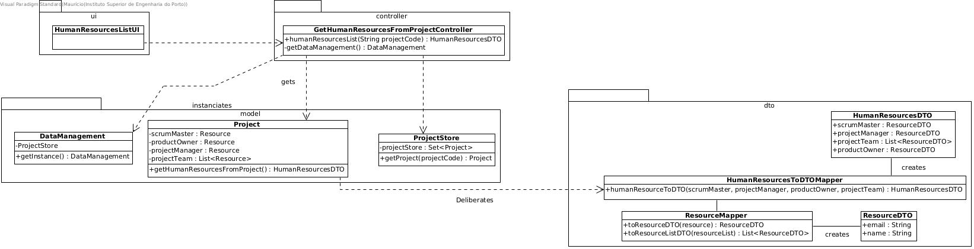
US28 – Class Diagram

Slide 29
Unit Tests JUnit
Unit Test 1 - getAllHumanResourcesListSuccessfully()
Unit Test 2 - getHumanResourceFromNullResourcesProject()
Unit Test 3 - getHumanResourceFromNullProjectCode()
Unit Test 4 - getHumanResourceFromNonExistentProject()

Slide 30
US29
AS PROJECT MANAGER, I WANT TO START A SPRINT
Author: Tânia Mota

Slide 31
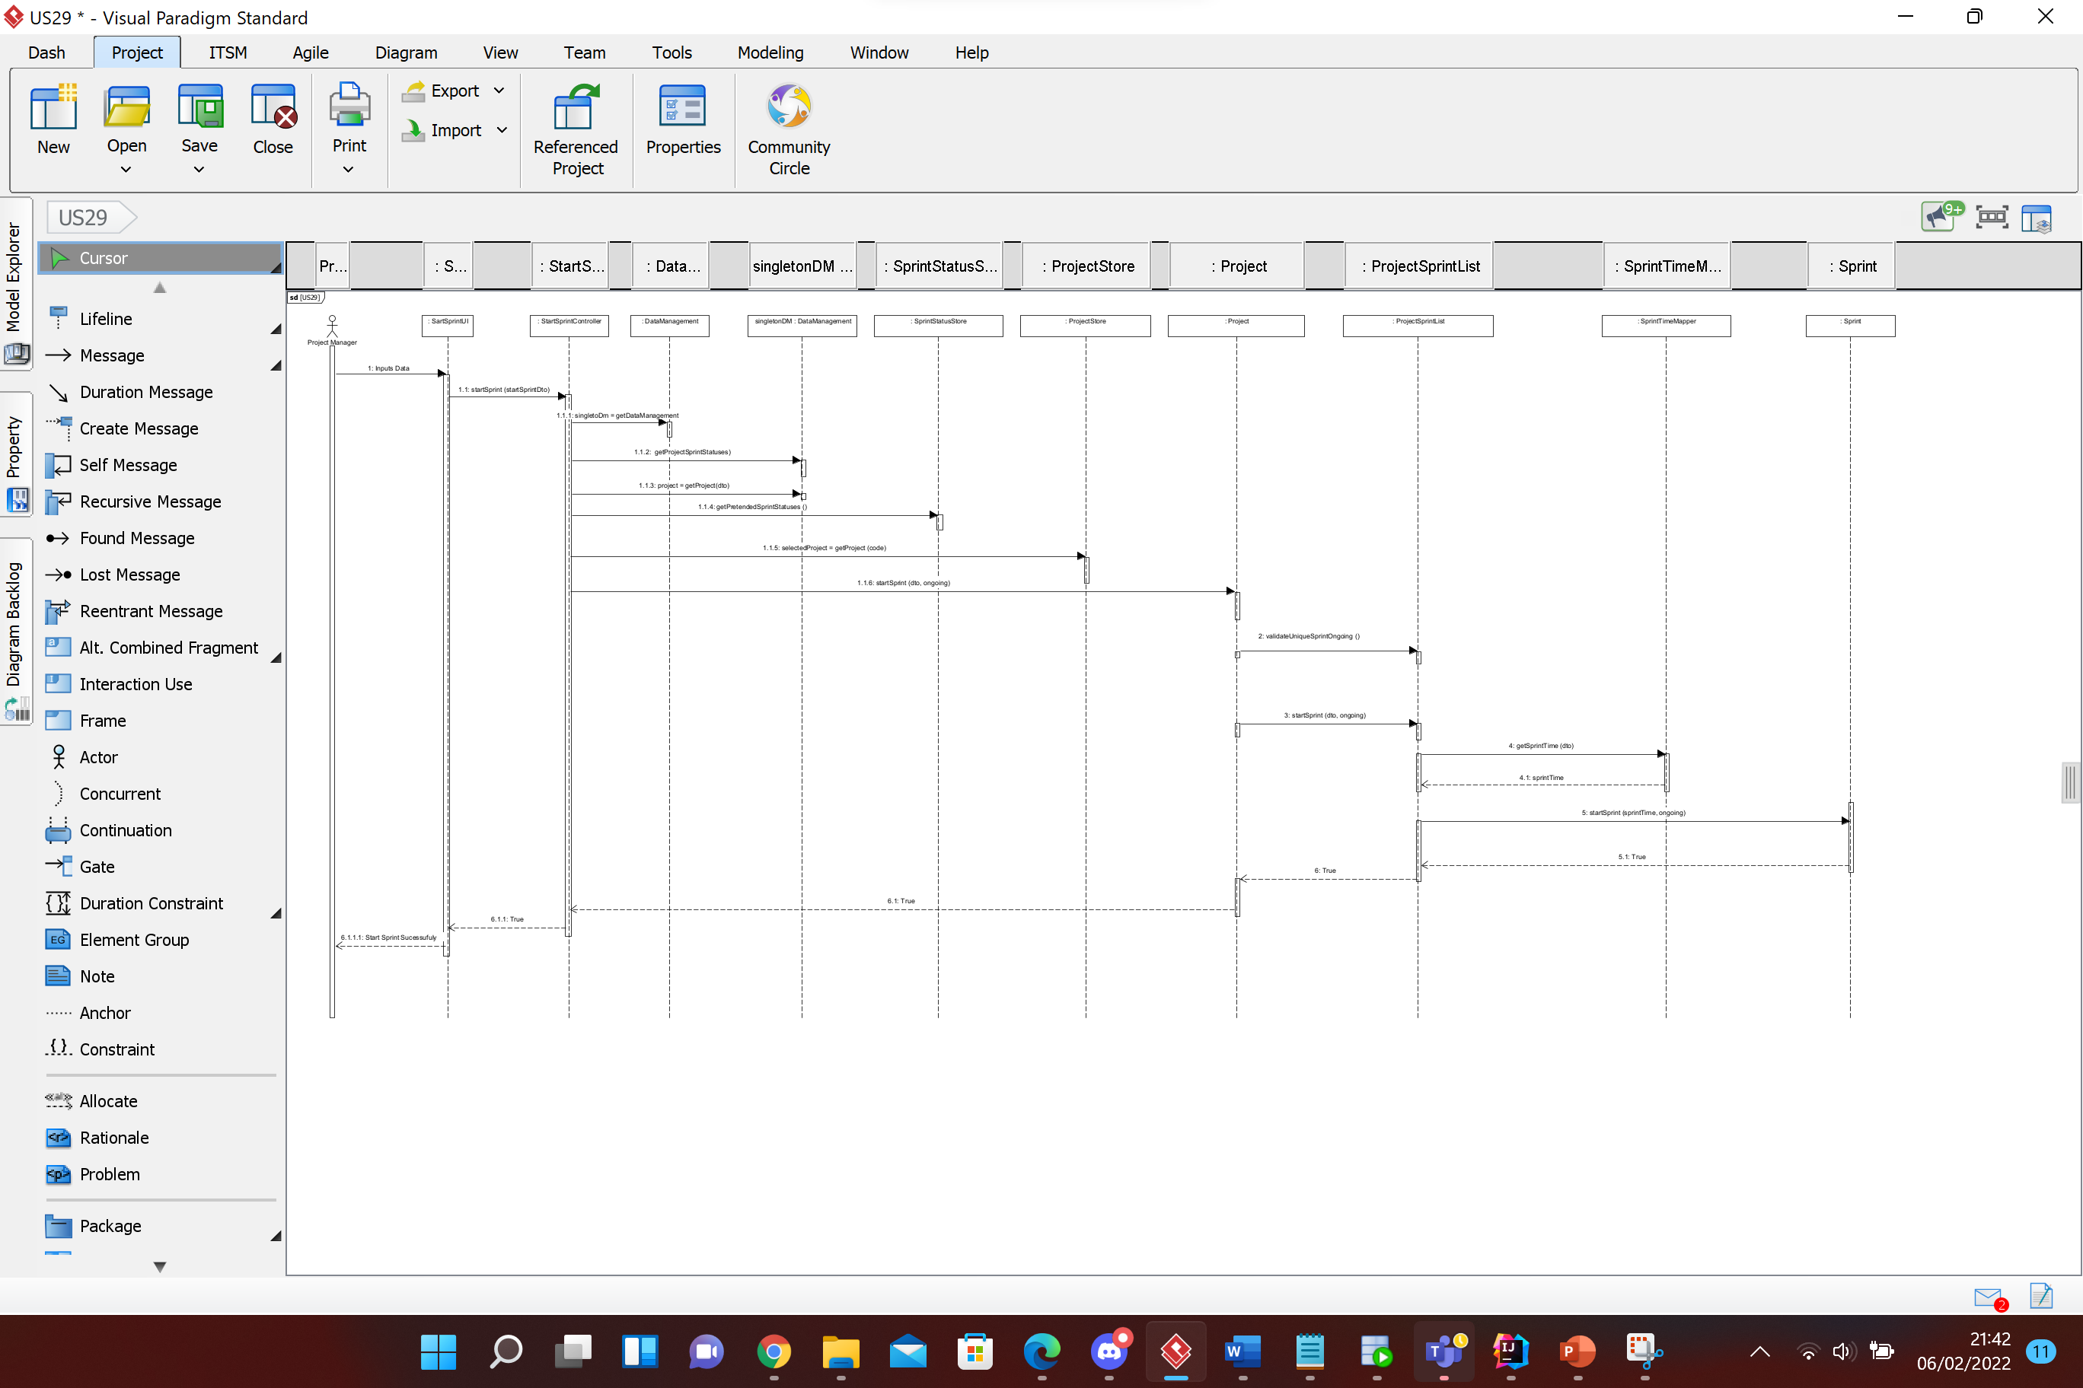

Slide 34
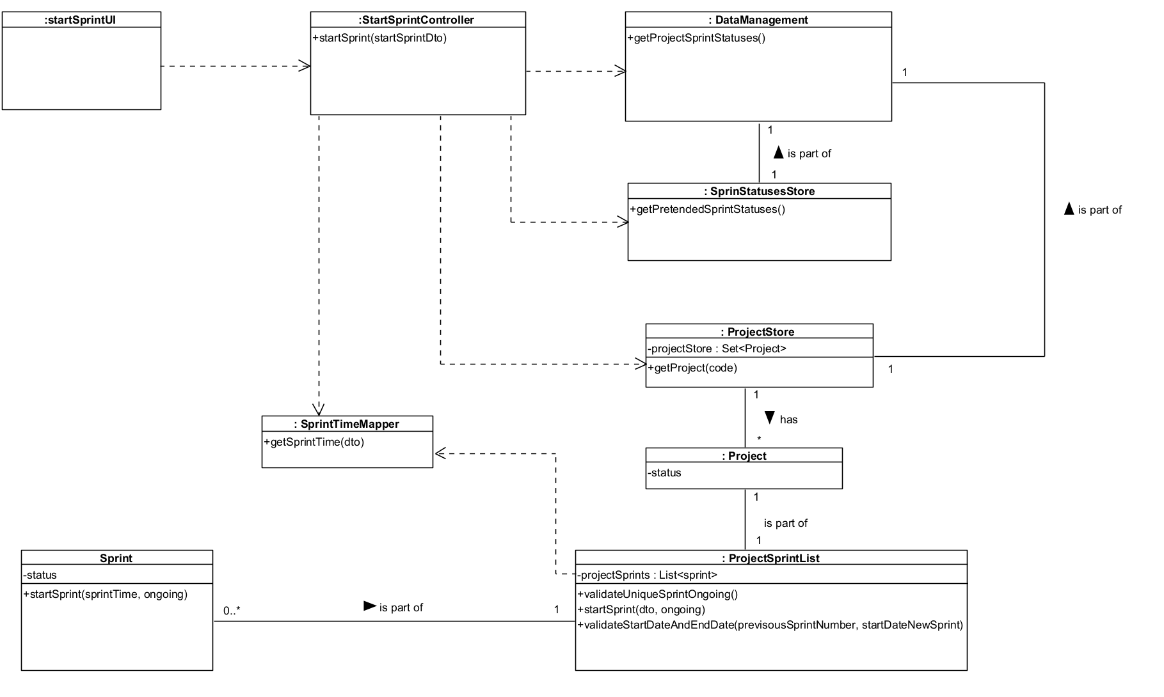

Slide 35
Unit Tests JUnit
Test 1 : Start a sprint sucessufuly
Test 2 : Start a sprint failure because:
The end date of the previous sprint is greater than the start date of the current sprint (ControllerTest)
The status in null (ProjectTest)
The Time is null (ProjectTest)
There is more than one sprint with the state “ongoing” (ProjectSprintListTest)
Test 3 : Validation if sprint with status “ongoing” is unique (ProjectSprintListTest)

Slide 36
US30
As Team Member, I want to view the Scrum Board of current sprint.

Slide 37
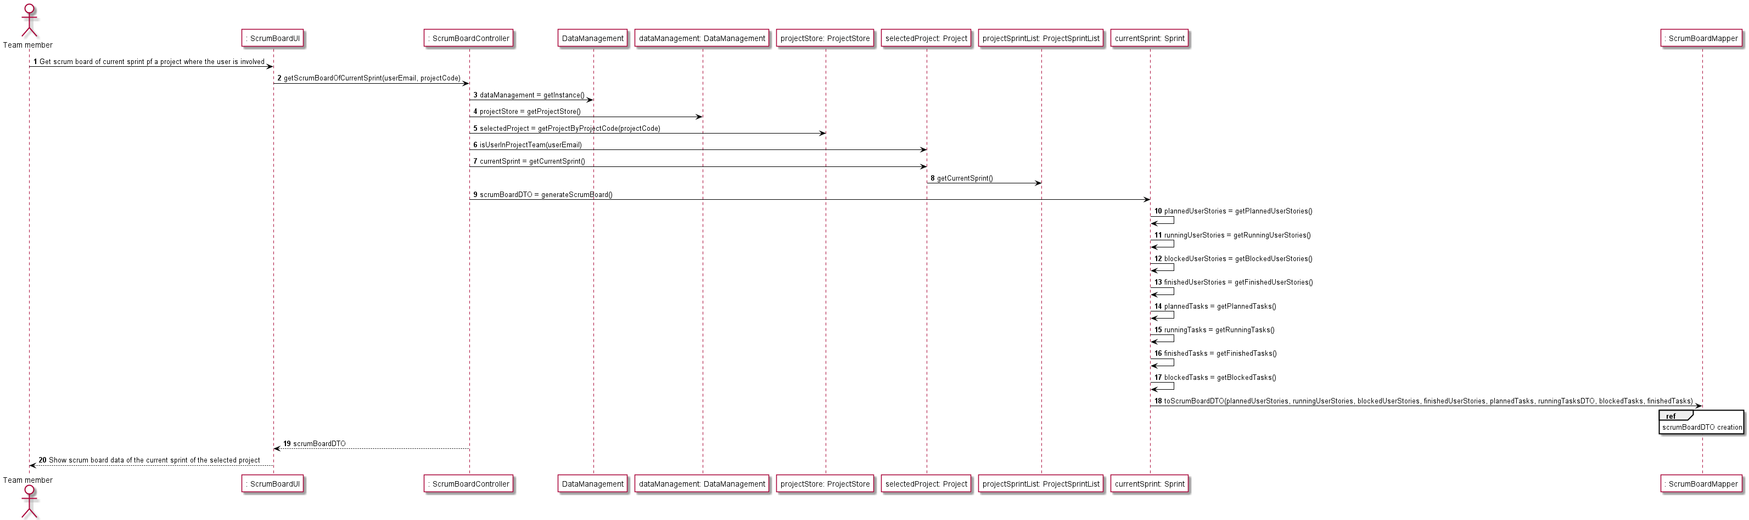
US 30 – Sequence Diagram

Slide 38
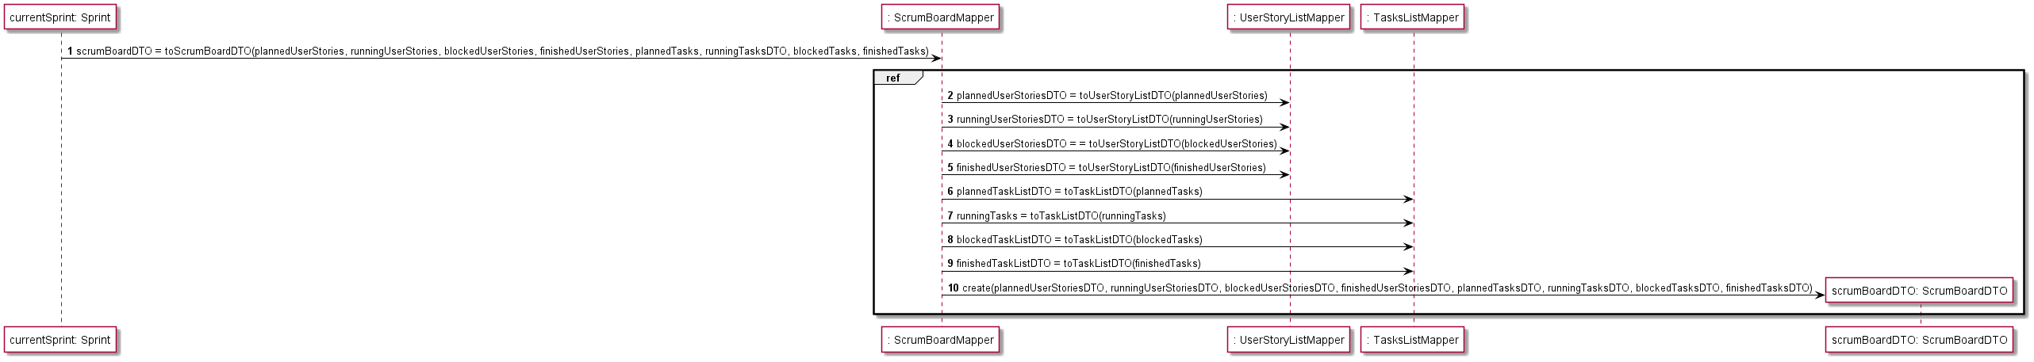
US 30 – Sequence Diagram

Slide 39
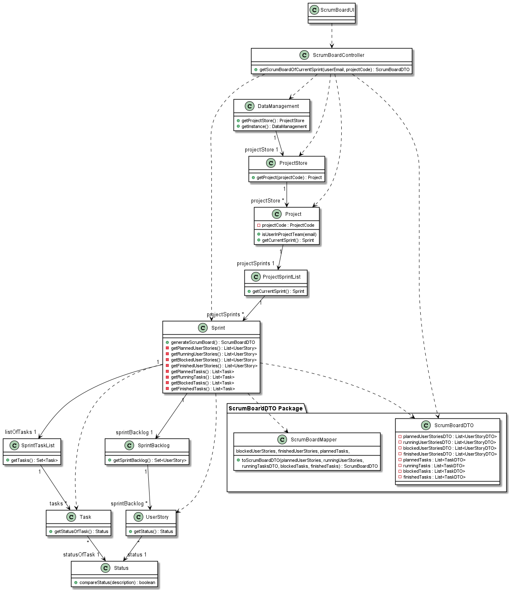
US30 – Class Diagram

Slide 40
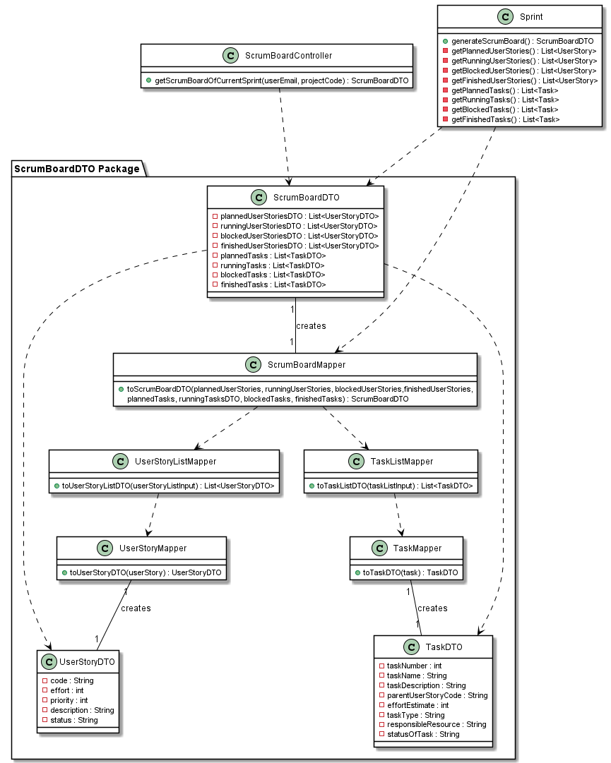
US30 – Class Diagram
Scrum Board DTO Package

Slide 41
Unit Tests JUnit
Unit Test 1: Creation of scrum board fails due to null inputs in the controller (user email and project code).
Unit Test 2: Creation of scrum board fails due to input project code does not respect the business rules established for the project code.
Unit Test 3: Creation of scrum board fails due to input user email does not respect the business rules established for the user email.
Unit Test 4: Creation of scrum board fails due to input project code not corresponding to a project in the project store.
Unit Test 5: Creation of scrum board fails due to input user email not corresponding to a team member in the selected project.
Unit Test 6: Creation of scrum board fails due to not existing a running sprint in the selected project.
Unit Test 7: Creation of scrum board is successful and a scrum board with lists of user stories and tasks, grouped by their current status, is returned.

Slide 42
US31
As Team Member, I want create a task in a user story.

Slide 43
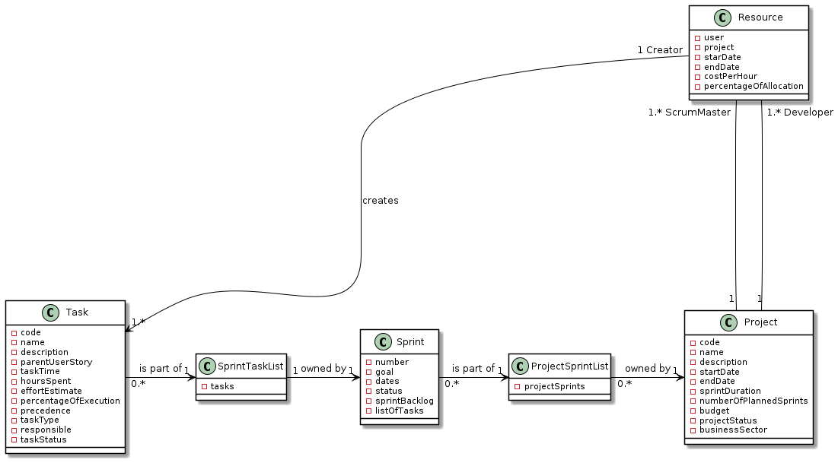
US 31 – Domain Model Excerpt

Slide 44
US 31 – Sequence Diagram

Slide 45
US 31 – Sequence Diagram

Slide 46
US 31 – Sequence Diagram

Slide 47
US31 – Class Diagram

Slide 48
Unit Tests JUnit
UNIT TEST 1: Creation of USTask is successful even though it doesn't have precedence list of tasks.
UNIT TEST 2: Creation of USTask is successful even though it doesn't have precedence list of tasks and valid Parent User Story.
UNIT TEST 3: Creation of USTask is successful having a precedence list with two valid tasks.
UNIT TEST 4: Creation of USTask is successful having a precedence list with one valid task.
UNIT TEST 5: Creation of USTask is successful even though it doesn't have a valid resource associated.
UNIT TEST 6: Creation of USTask is successful even though the selected User Story is invalid because its status is finished.
UNIT TEST 7: Creation of USTask Fails because Project is Invalid.
UNIT TEST 8: Creation of USTask Fails because Sprint is Invalid.
UNIT TEST 9: Creation of USTask Fails because Sprint Status is Done.

Slide 49
US32
As Team Member, I want create a task outside the scope of a user story.

Slide 50
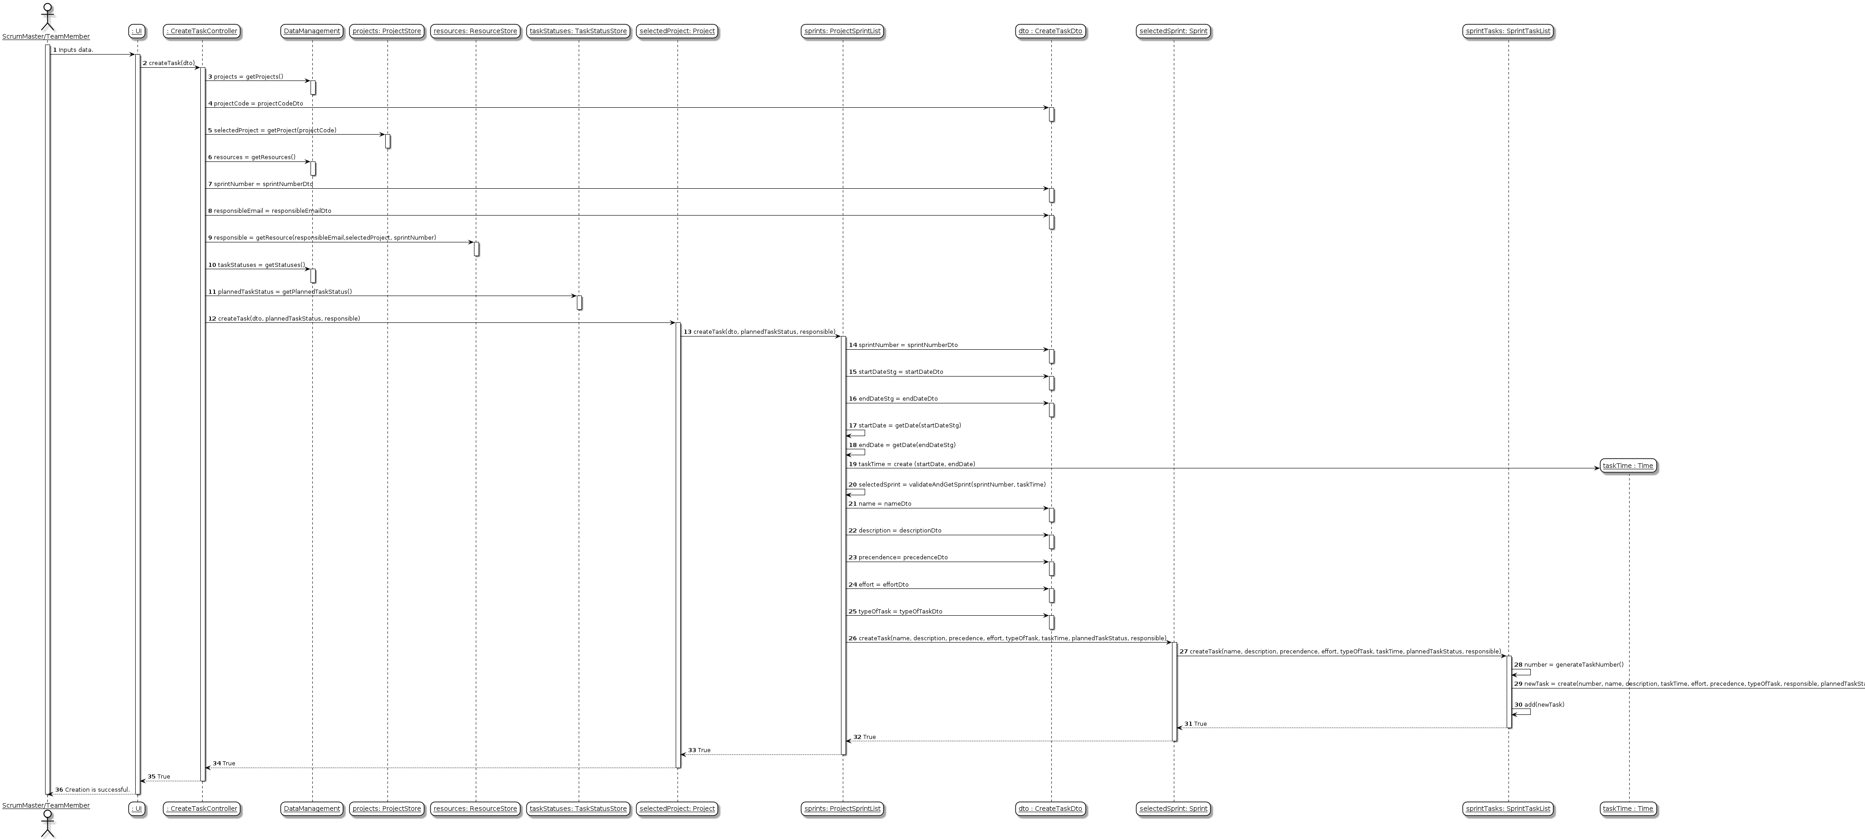
US 32 – Sequence Diagram

Slide 51
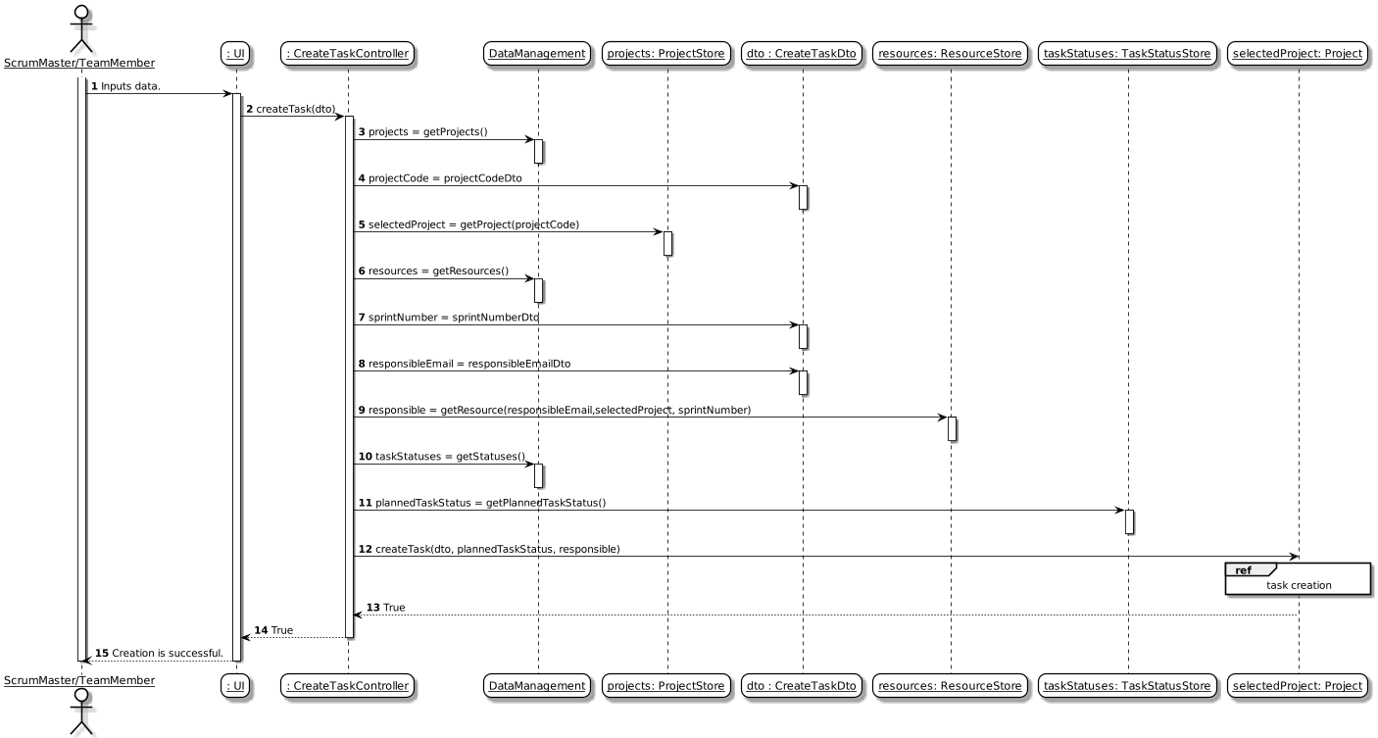
US 32 – Sequence Diagram

Slide 52
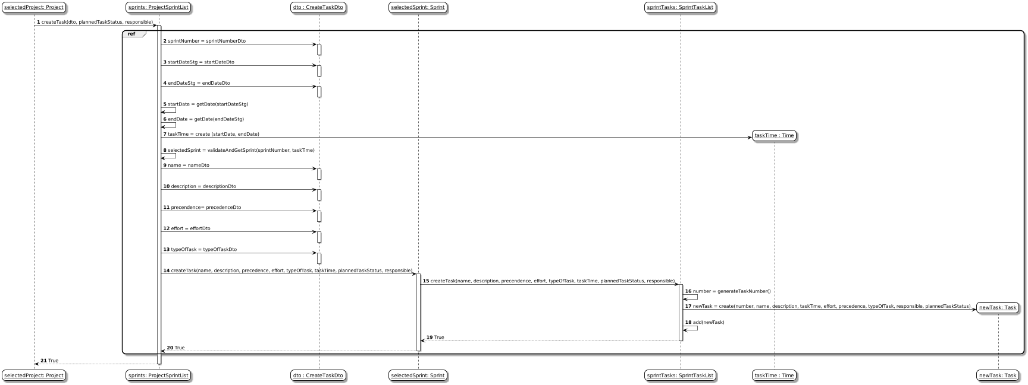
US 32 – Sequence Diagram

Slide 53
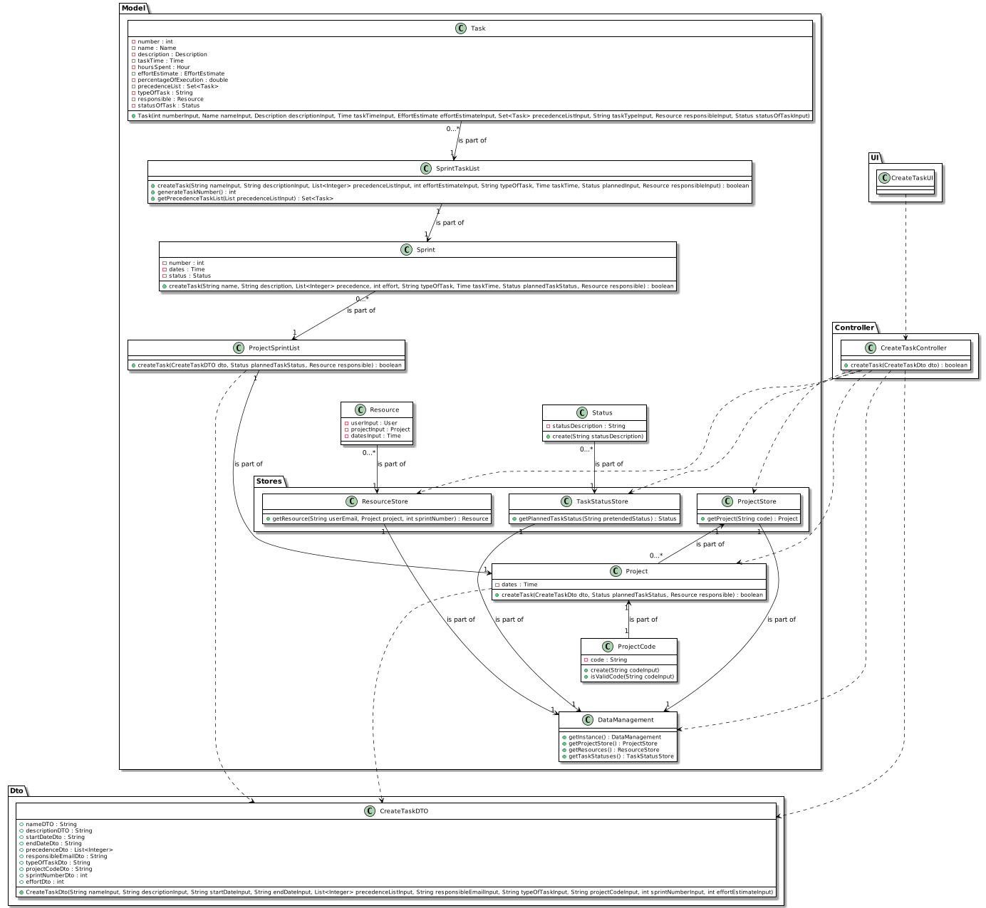
US32 – Class Diagram

Slide 54
Unit Tests JUnit
UNIT TEST 1: Creation of Task is successful even though it doesn't have precedence list of tasks.
UNIT TEST 2: Creation of Task is successful even though it doesn't have a valid Resource associated.
UNIT TEST 3: Creation of Task fails because Project is invalid.
UNIT TEST 4: Creation of Task fails because Sprint is Invalid.
UNIT TEST 5: Creation of Task fails because Sprint Status is done.

Slide 55
US33
US033 - As SM/Team Member, I want to register work done on a Task

Slide 56
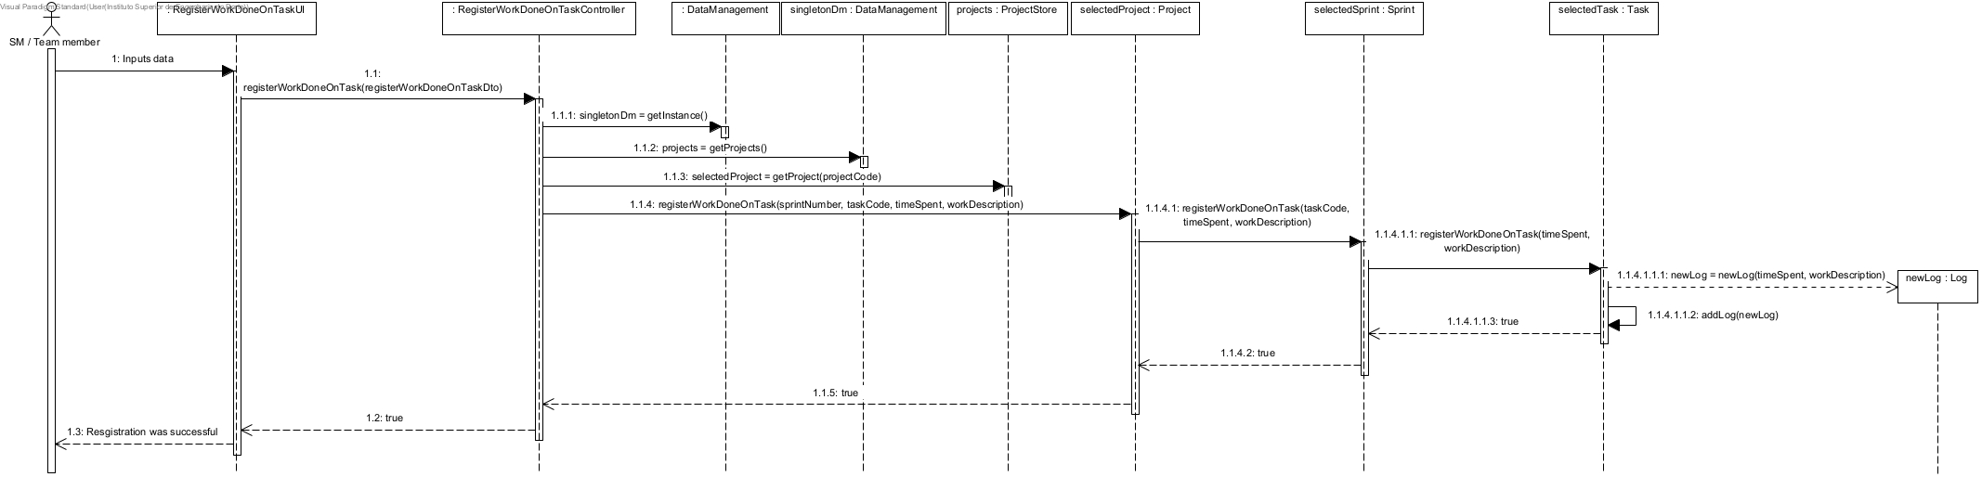
US 33 – Sequence Diagram

Slide 57
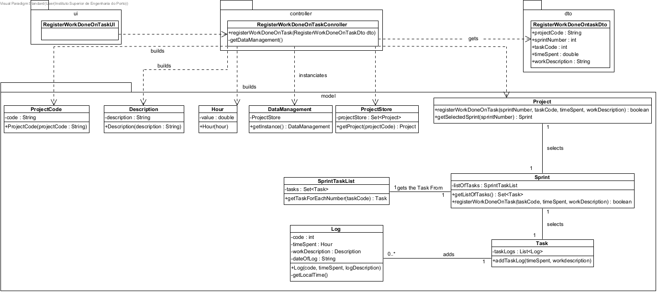
US33 – Class Diagram

Slide 58
Unit Tests JUnit
Unit Test 1: Success case.
Unit Test 2: Controller fails when is passed a null String as project code.
Unit Test 3: Controller fails when is passed a non existent project code.
Unit Test 4: Controller fails when is passed an invalid project code.
Unit Test 5: Controller fails when is passed an invalid sprint number.
Unit Test 6: Controller fails when is passed a non existent sprint number.
Unit Test 7: Controller fails when is passed an invalid task code.
Unit Test 8: Controller fails when is passed a non existent task code.
Unit Test 9: Controller fails when is passed and invalid hour.

Slide 59
US34
US034 - As Project Member, I want to update the status (i.e: the scrum board category) of a user story in the scope of the current sprint backlog.

Slide 60
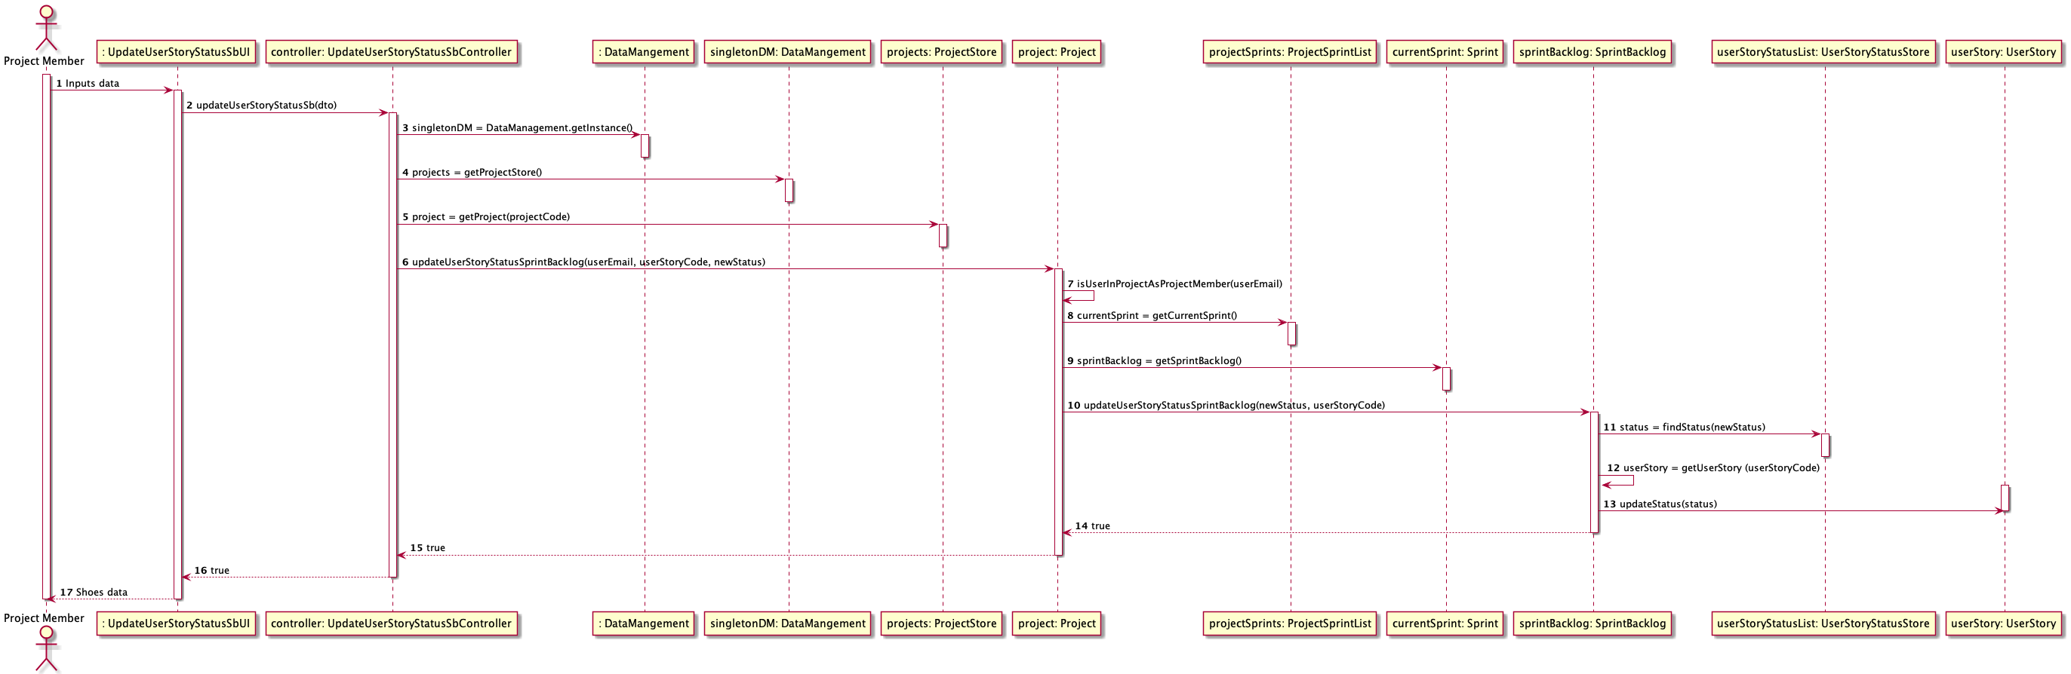
US 34 – Sequence Diagram

Slide 61
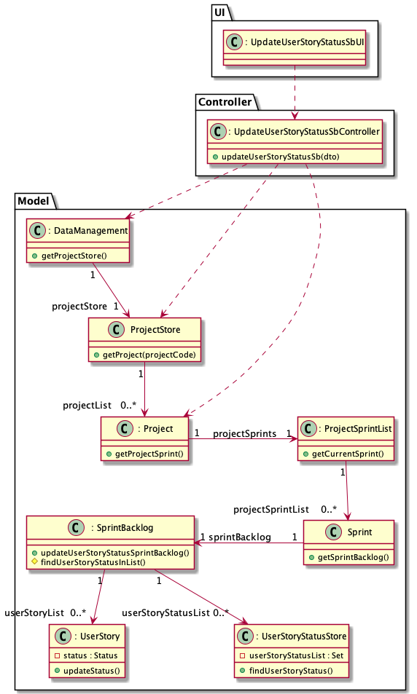
US34 – Class Diagram

Slide 62
Unit Tests JUnit
Unit Test 1: updateStoryStatusSuccessfully()
Unit Test 2: updateStoryStatusUnsuccessfullyNonExistsProject()
Unit Test 3: updateStoryStatusUnsuccessfullyEmailNotBelongToProject()
Unit Test 4: updateStoryStatusUnsuccessfullyUserStoryNonExistsInProject()
Unit Test 5: updateStoryStatusUnsuccessfullyUserStoryStatusNonExists()
Unit Test 6: updateStoryStatusUnsuccessfullyParamNull()
Unit Test 7: updateStoryStatusUnsuccessfullyProductOwner()

